Slide 1
Microgrid Design and Model
Jaimerson Valleser, M.Eng

Slide 2
Discussion Points
Key Attributes
Salient Features Microgrid
Components of Microgrid Power System
Potential of Wind and Solar
Design Philosophy and Mathematical Model and Control System
Architecture and Infrastructure of BESS
Energy Management Algorithm

Slide 3
Key Attributes of Microgrid
The Microgrid Power System (MGPS) is an independent small-scale network of renewable energy sources such as Solar, Wind, and Biogas with a Battery Energy Storage System (BESS)
It is capable of providing electricity within a definable boundaries or autonomous areas of a certain community.
Excess capacity are stored efficiently and this prevent load curtailment during power shortages
Can be operated in an Island mode or connected to the main Grid
It is a distributed energy resources that allows local generation for domestic loads
It is a highly efficient and very flexible integrated system of generation resource

Slide 4
Salient Features of Microgrid
Transmission System is highly reduced, thus it cuts down demand charges, transmission charges, etc.
Promotes substantial savings in fuel cost
It Lowers CO₂ emission to the environment.

Slide 5
Salient Features of Microgrid
The system frequency is highly balanced
Good power quality is achieved
Improvement of energy system reliability

Slide 6
Component of Microgrid System
Customers, Electricity Users
Controls, Protection, Regulators
Generator Resources and Distribution System

Slide 7
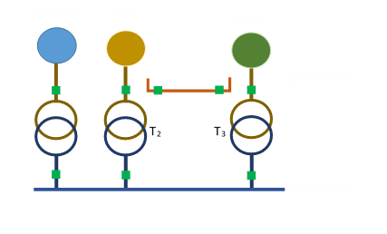
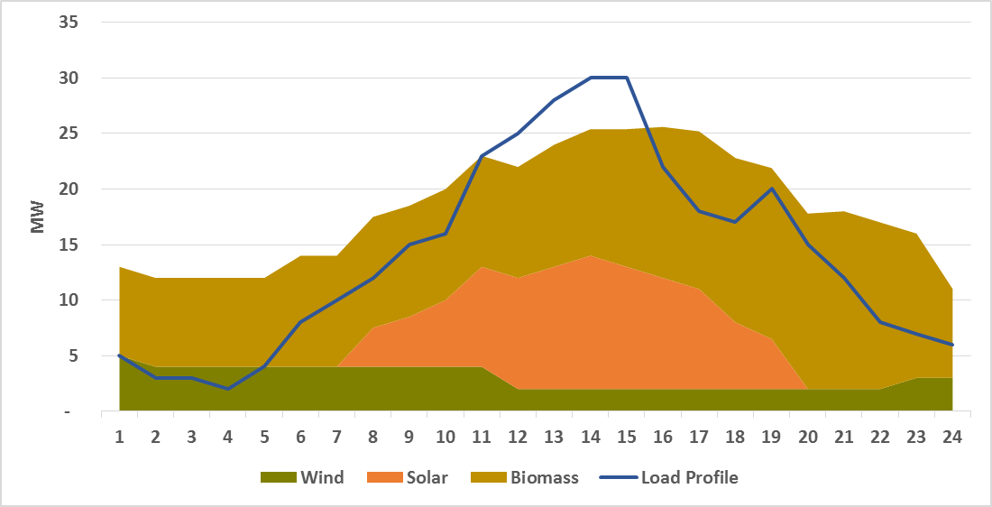
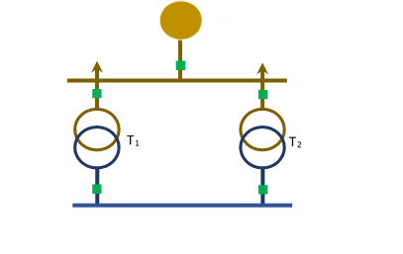
Component of Microgrid System
MGCMCS

Slide 8
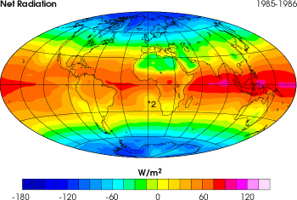
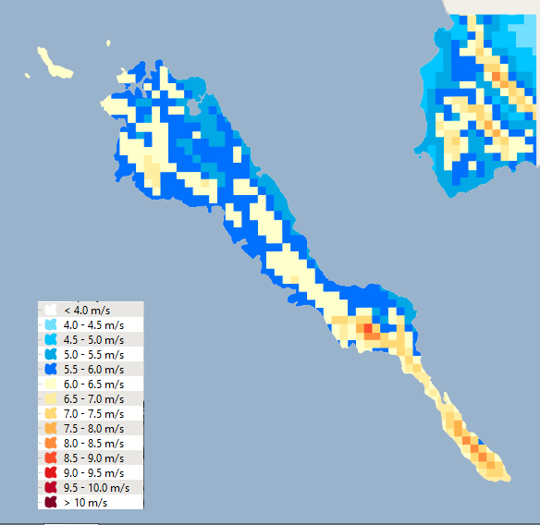
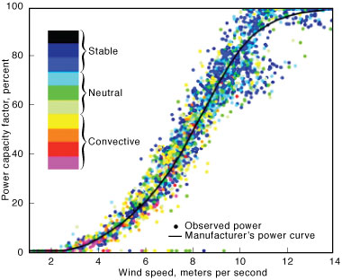
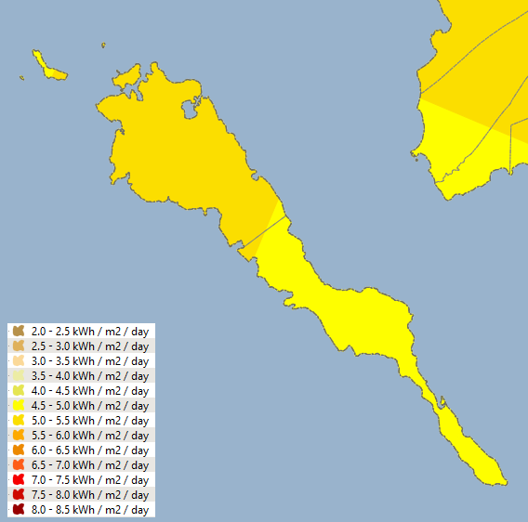
Understanding the Potential of Wind and Solar
Wind Speed
Solar Irradiance

Slide 9
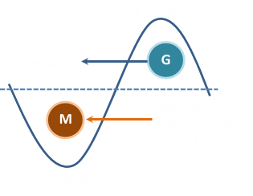
Mathematical Model
Power Balance
P_{BIO} + P_{SOLAR} + P_{WIND} + P_{BESS-Dis} + P_{slack1}= P_{Load} + P_{Loss} + P_{BESS-Cha} + P_{slack2}
Power delivered by BESS when
P_{BIO} + P_{SOLAR} + P_{WIND} < P_{Load} + P_{Loss}
Power absorbed by BESS when
PBIO + PSOLAR + PWIND > PLoad + PLoss

Slide 10
Design Philosophy of Control System
P_{Bio}
P_{Wind}
P_{Solar}
P_{BESS}
RTU₁
MQ₁
RTU₂
MQ₂
RTU₃
MQ₃
RTU₄
MQ₄
MGMCS
RTU₅
MQ₅
RTU₆
MQ₆
RTU₇
MQ₇

Slide 11
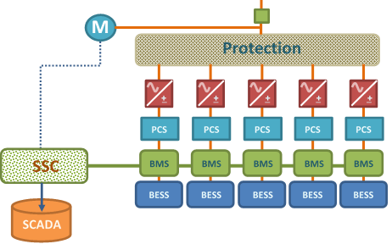
Design Architecture and Infrastructure of BESS
System Supervisory Control
Power Control and Switching Facilities
Battery Management System
Battery Energy Storage System

Slide 12
Energy Management Algorithm
Check Availability of Solar, Wind, Bio and BESS
Evaluate
P _{supply} = P _{load} + P _{loss}
Check Battery SOC
Check Battery SOC
N
Load balance<0
Y
Y
SOC>20%
Generate
Y
N
Bio Available?
N
SOC>80%
Check BIO availability
N
Y
Get power from the main Grid
Run Bio
Charge the Battery
Generate
Supply-Demand balance?
Supply and Demand is balance

Slide 13
Development of Microgrid
Screening Study
Set Goals
Acquire Approval and Permits
Organized and educate
Acquire Financing
Identify Project Site
EPC
Study the Concept

Slide 14
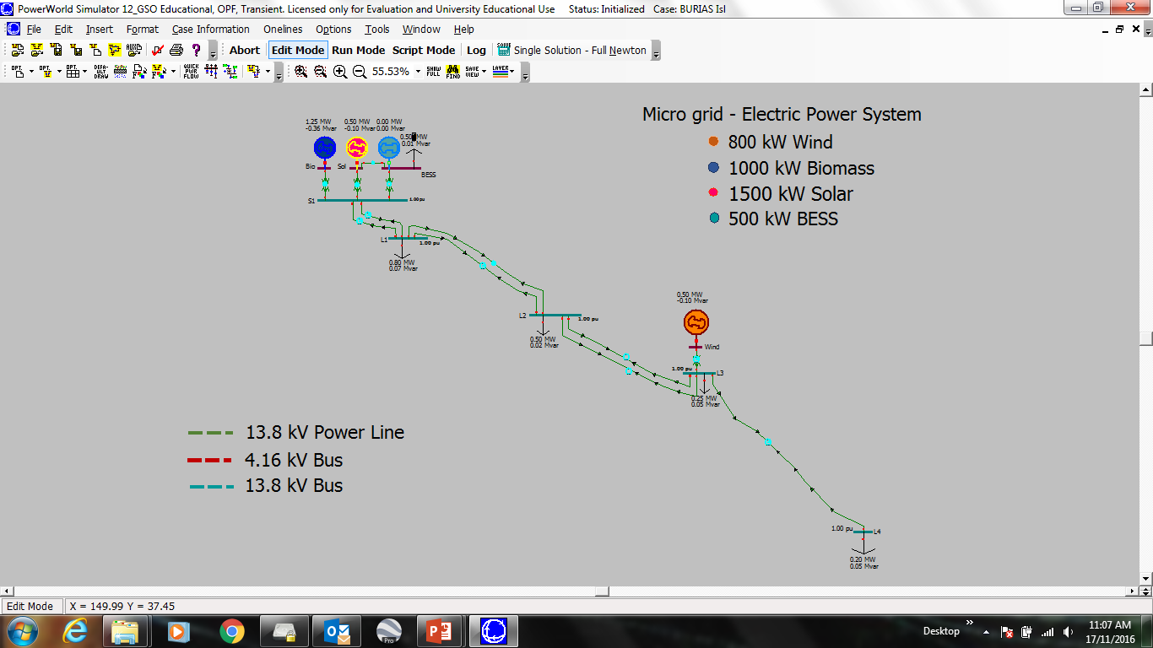
Microgrid Power System

Slide 15
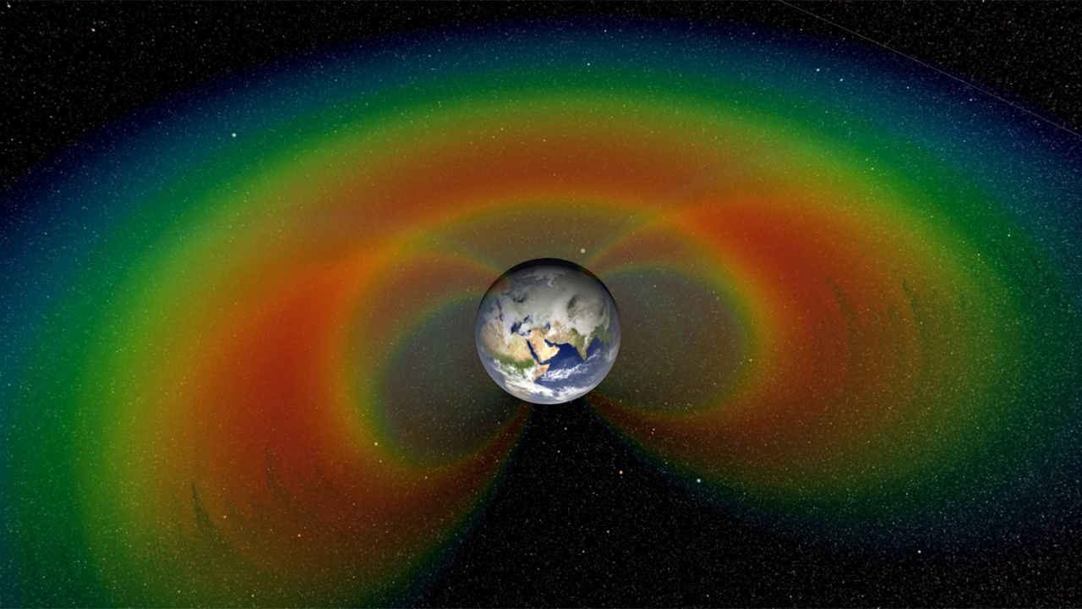
Thank you

